Slide 1
The Cameo Concept Modeler
Jim Logan, Director and Product Manager

Slide 2
Agenda
What do we mean by “Concept Model”?
What is the Cameo Concept Modeler (CCM)?
How CCM can help with working group activities
A supported modeling methodology
Supported ways to consume a concept model
A deeper dive into capabilities (Time Permitting)
How to evaluate CCM (and other tools)

Slide 3
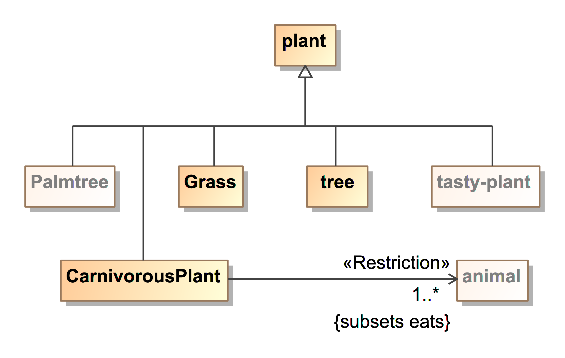
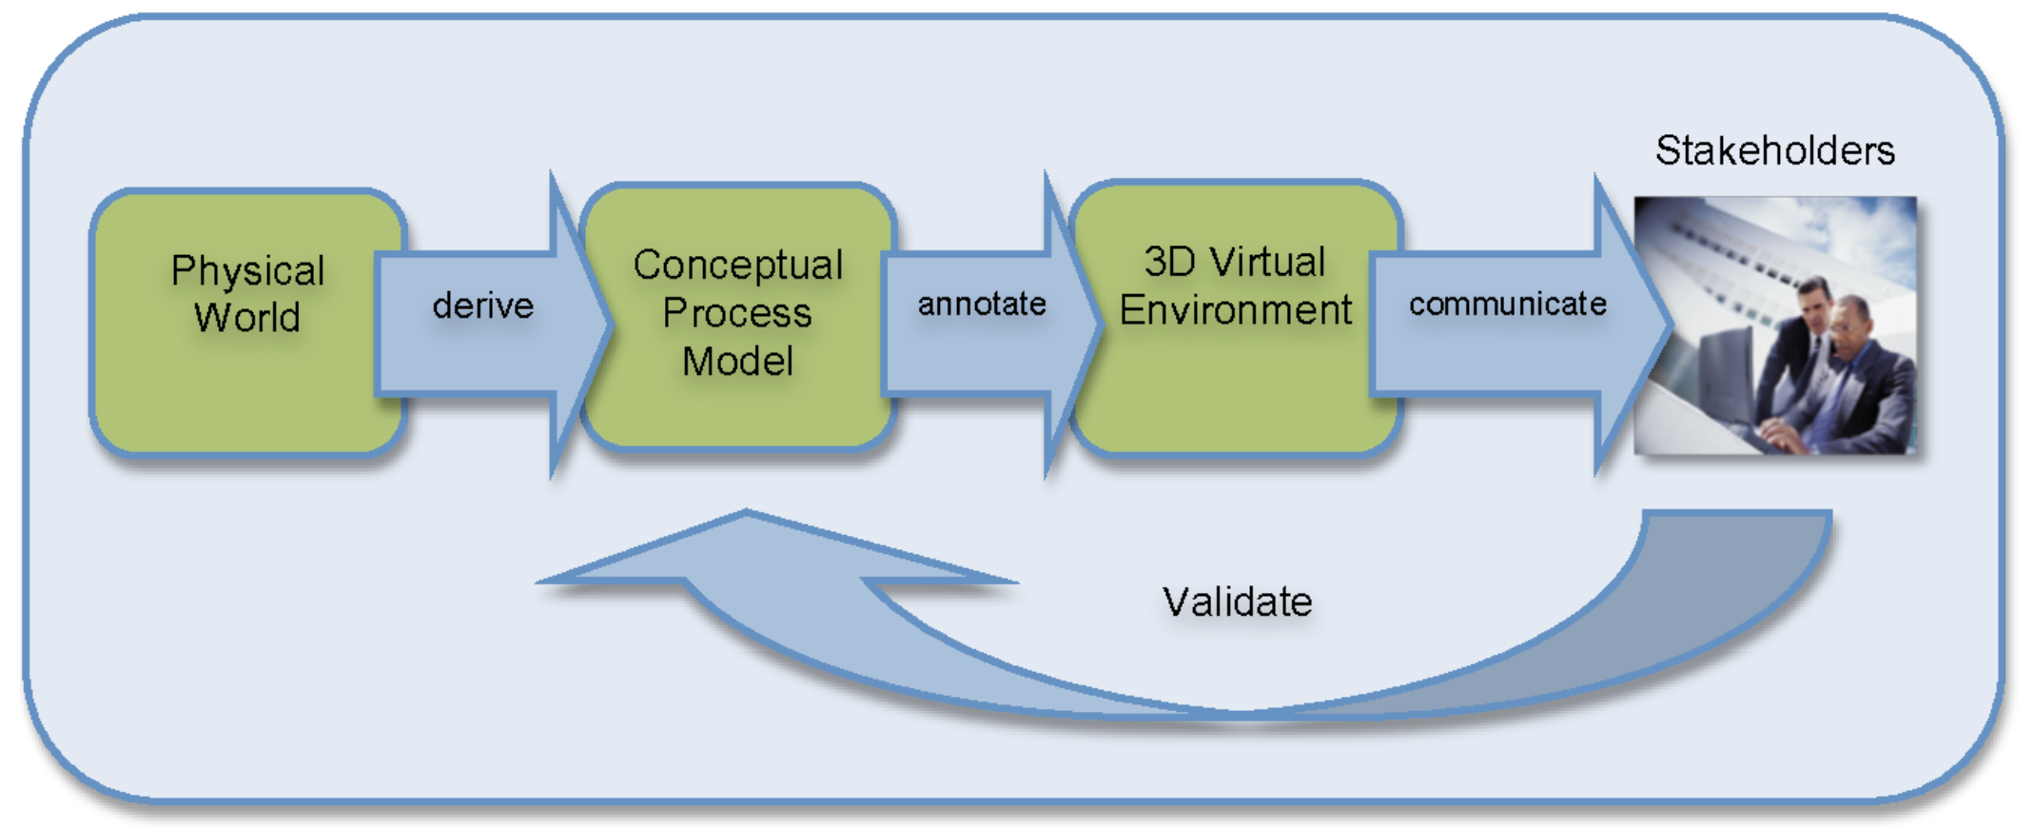
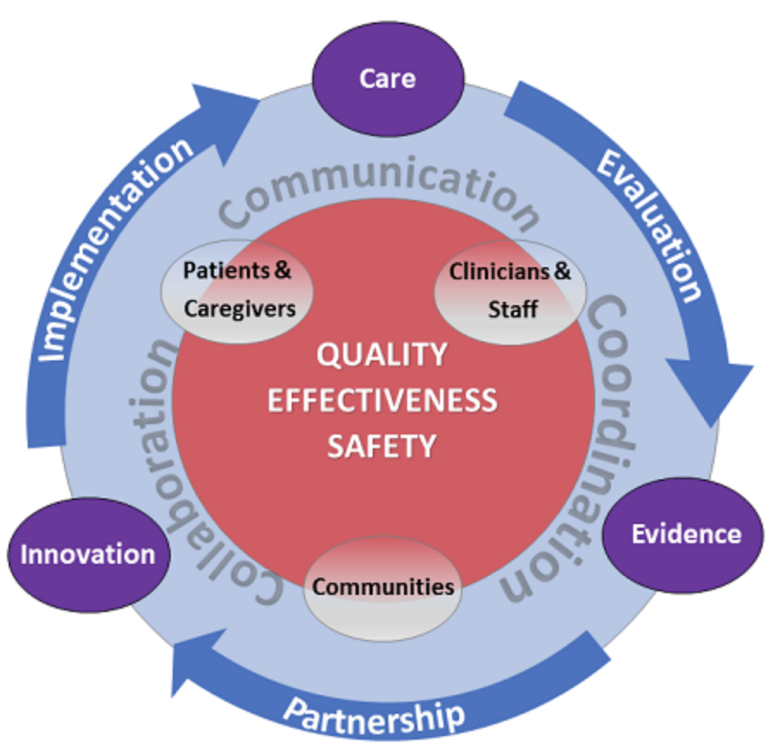
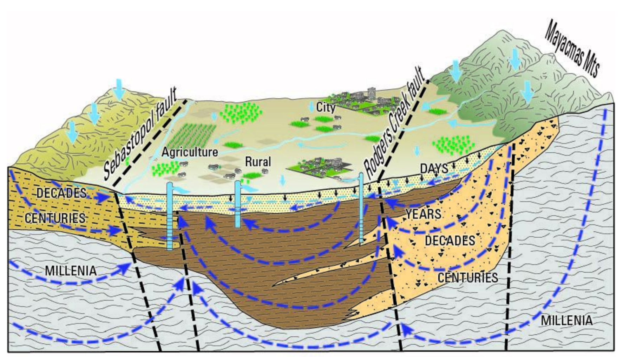
First, What Do We Mean by a “Concept Model”?
A less spooky way to say “ontology”
A separation from design decisions and data structures
A way to differentiate from some kinds of “conceptual models”
❌
❌
❌

Slide 4
What is the Cameo Concept Modeler?
A plug-in that extends the award-winning MagicDraw UML platform
A tool for multiple people to author concept models graphically
Connects the OMG and W3C ecosystems
(Re-)imports, explains, and extends existing ontologies (E.g. BFO in OWL 2)
Exports concept models to the Web Ontology Language (OWL 2)
Maps concept models to other models (e.g., analysis, architecture, design, business process)
A way to validate concept models with SMEs, in plain English, using only a web browser
Plus a lot more, as follows

Slide 5
Are You Using a Process Like This?
Elicitation
Analysis
Synthesis
Publication
Validation
Interviewing SMEs
Active listening
Note taking
Rough ontology modeling
Understanding
Error marking
Discussion
Gap finding
De-conflation
Defining genus-differentiae
Ontology alignment
Document production
Web access
Quality ontology modeling
Reasoning / testing
Annotation / documentation

Slide 6
How the Cameo Concept Modeler Can Help
Allows more people to participate in ontology production and consumption
Leverages the familiar and standardized UML graphical notation
Eliminates misunderstandings with pop-up explanations
Progressively validates and offers to simplify constructs
Allows more people to understand and validate an ontology
Explains models in plain English, as HTML glossaries
Hides or shows complexity on diagrams, as needed
Easily navigates to a diagram that fully defines a concept
Provides compatibility with all Semantic Web tools (using OWL2)
Encourages the deferral of technical design decisions

Slide 7
How the Cameo Collaborator Helps
Requires only a web browser
Publishes models to a web server
Provides web access to diagrams and glossaries
Allows visual or textual mark-up
Provides comment / discussion threads

Slide 8
How TeamWork Cloud Server Helps
Makes model versions accessible from one place (similar to Github or Subversion)
Controls access to models
Allows multiple simultaneous authors (similar to Overleaf, Google Docs, Github)
Also allows private branches, with a later visual merge
Scales for very large enterprise-level modeling efforts

Slide 9
Putting It All Together
Elicitation
Analysis
Synthesis
Publication
Validation
Interviewing SMEs
Active listening
Note taking
Rough ontology modeling
Understanding
Error marking
Discussion
Gap finding
De-conflation
Defining genus-differentiae
Ontology alignment
Document production
Web access
Quality ontology modeling
Reasoning / testing
Annotation / documentation

Slide 10
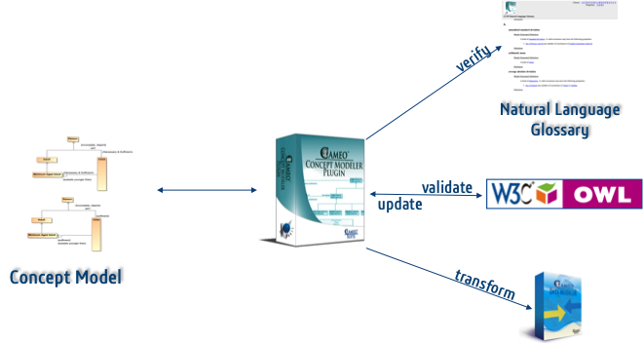
A Supported Modeling Methodology
Separate concept modeling from information modeling
Import the BFO upper ontology (OWL 2)
Define concepts in a domain
Genus (i.e., superclass, ultimately from BFO)
Differentiating relations
Curate a small vocabulary of well-defined relations
Defer system design concerns
Validate with subject matter experts (and share) in plain English
Generate documents and machine-readable artifacts
Re-ingest edits from OWL 2 ontology formats

Slide 11
Supported Ways to Consume a Concept Model
For business / enterprise architecture (e.g., UAF, BPMN, SysML, UML)
Define architectural elements with concepts
Realize concepts with architectural elements
Link terminology in requirements, analyses, architectures, and designs to concepts
For training or working with other disciplines, share plain-English Glossaries
For information systems development
Apply design decisions to a concept model to generate mapped information models
Extract relevant concepts and relations
Flatten and combine concepts and relations into a contextually-optimized information model
Remember design decisions to re-apply when a concept model changes
Retain mappings for information federation
Provide impact analysis of concept model changes
(We have a proof of concept working now)
CCM works with all our other products that support these activities

Slide 12
A Deeper Dive into Capabilities (Time Permitting)

Slide 13
Upper Ontologies
CCM is tested with
Basic Formal Ontology (BFO)
Widely used for biomedical, security, and defense domains
Now in use at the Industrial Ontology Foundry (IOF)
Descriptive Ontology for Linguistic and Cognitive Engineering (DOLCE)
Yet Another More Advanced Top-level Ontology (YAMATO)
Planned
Make upper ontologies available as easy-to-use CCM libraries
Incorporate ideas from OntoClean to find modeling mistakes

Slide 14
Increased UML Expressivity
Concept to concept relations (e.g., equivalence)
Complex cascades of anonymous concepts (e.g., qualified cardinality, intersection, negation)
Concept to individual relations (e.g., instantiation, nominalization)
Individual to individual relations (e.g., sub-properties, property chains)
Property characteristics (e.g., functionality, reflexivity, symmetry)
Documentation using various annotation properties
Untyped, global properties in instance specifications

Slide 15
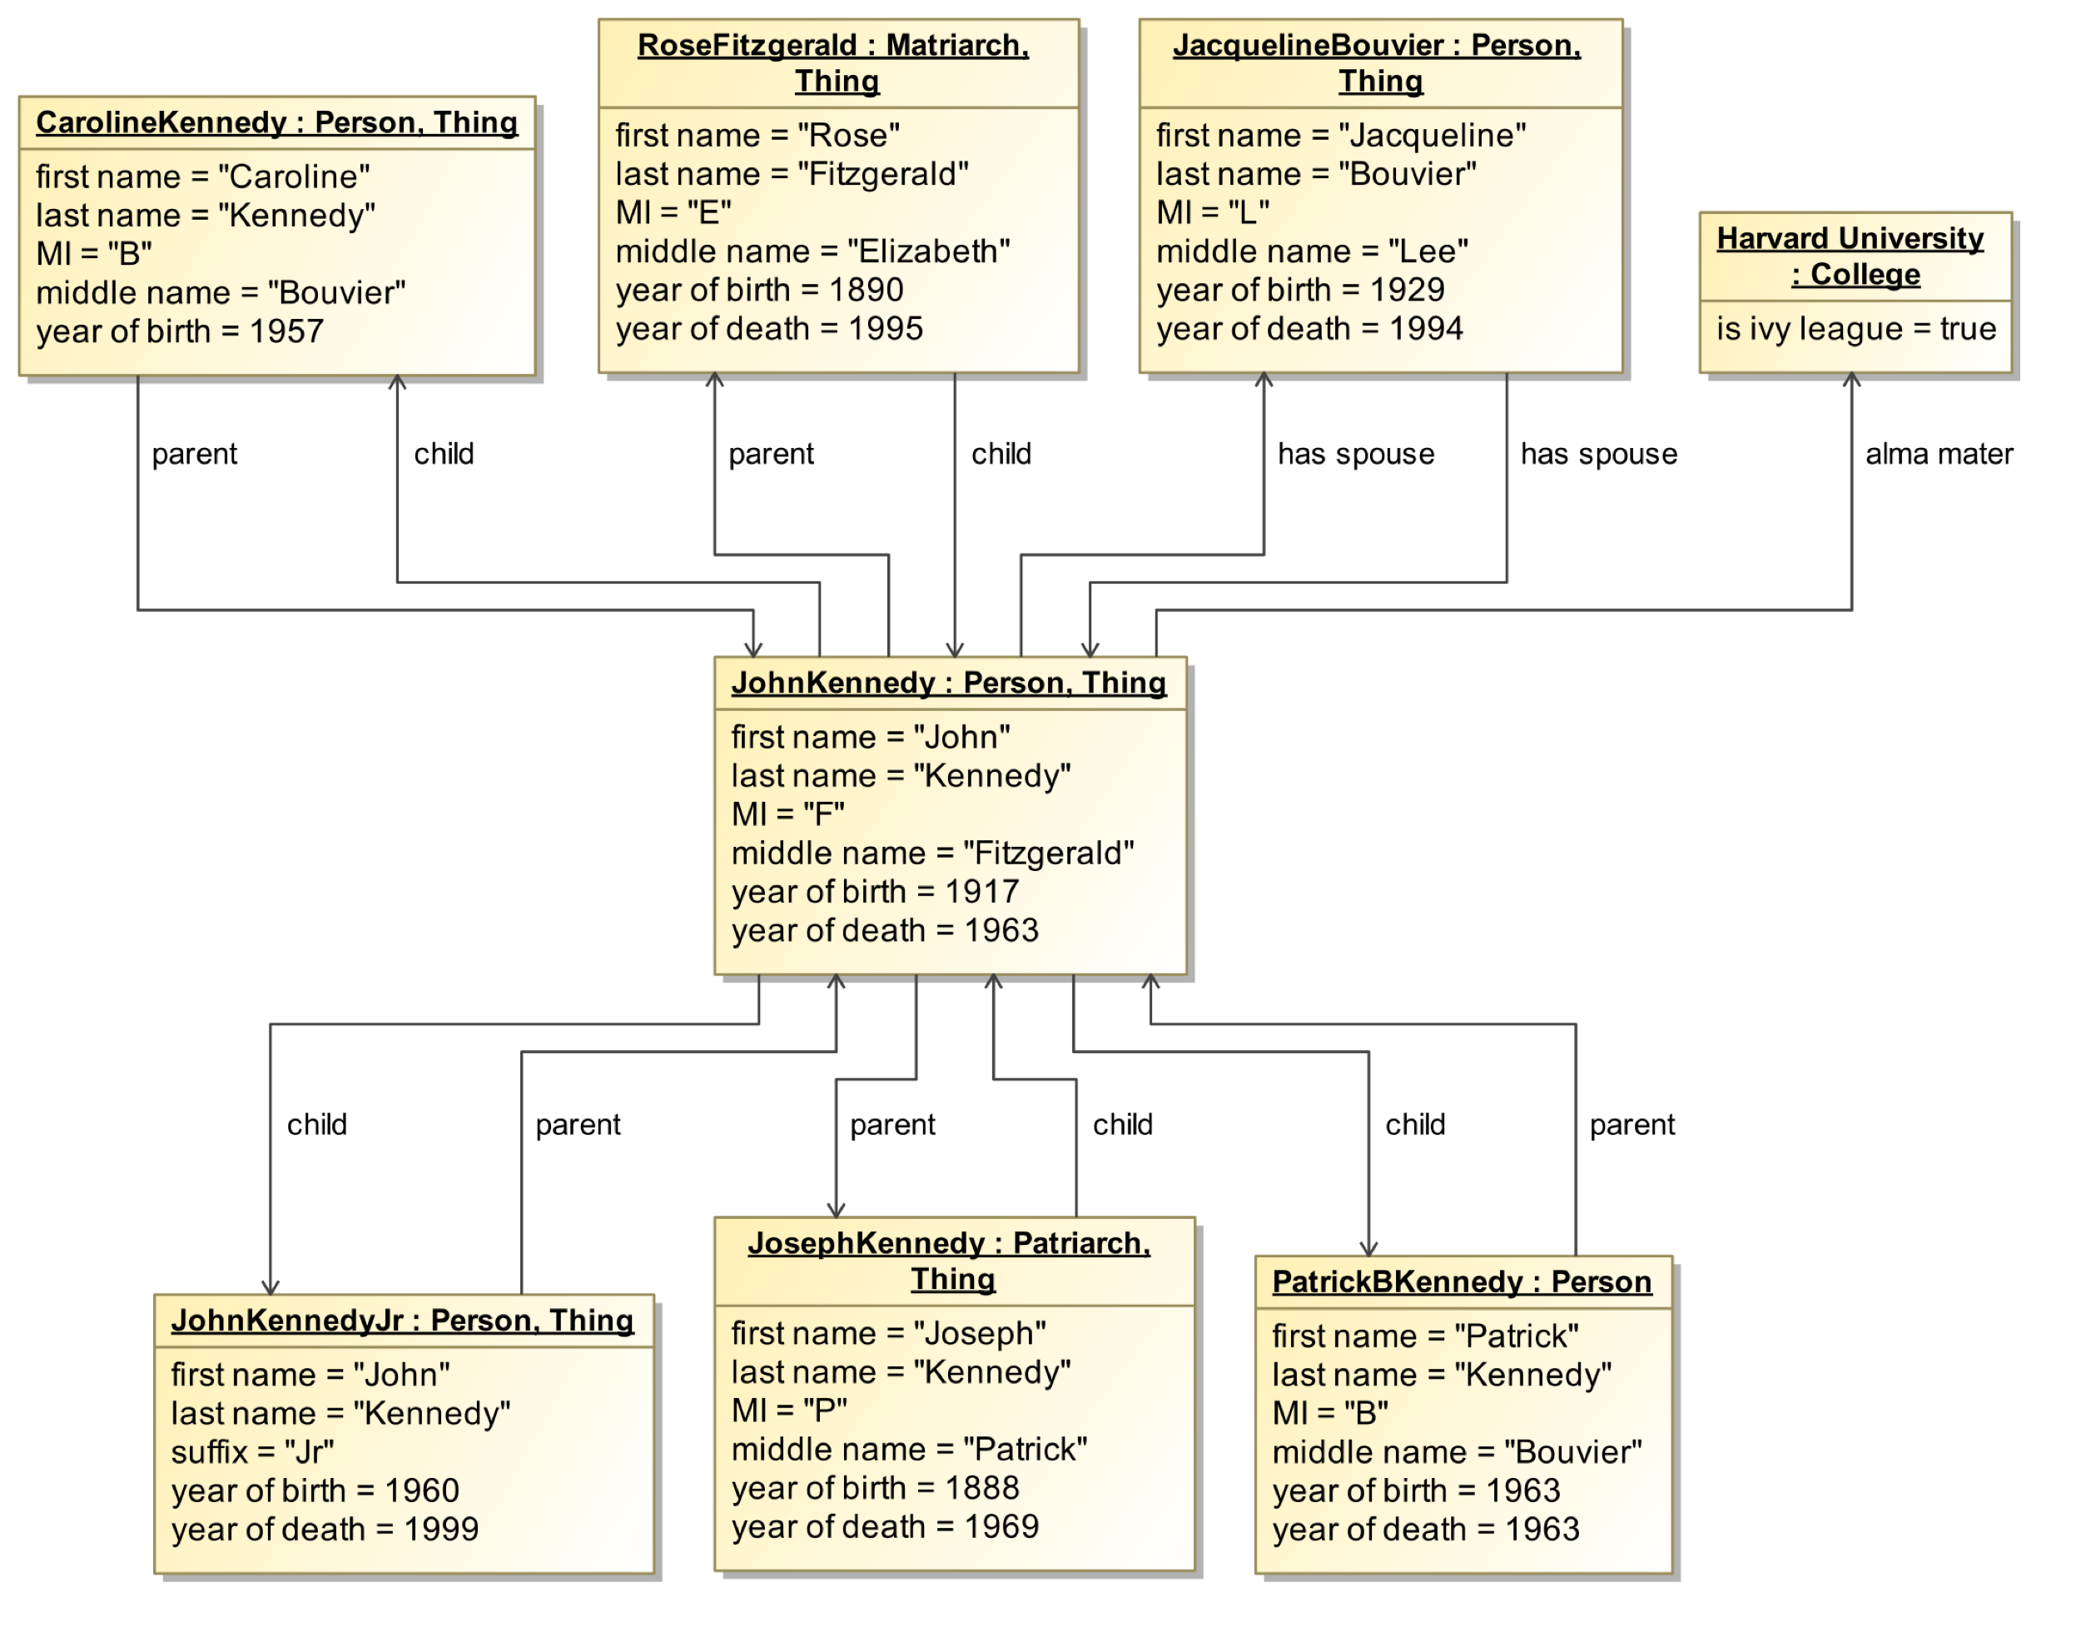
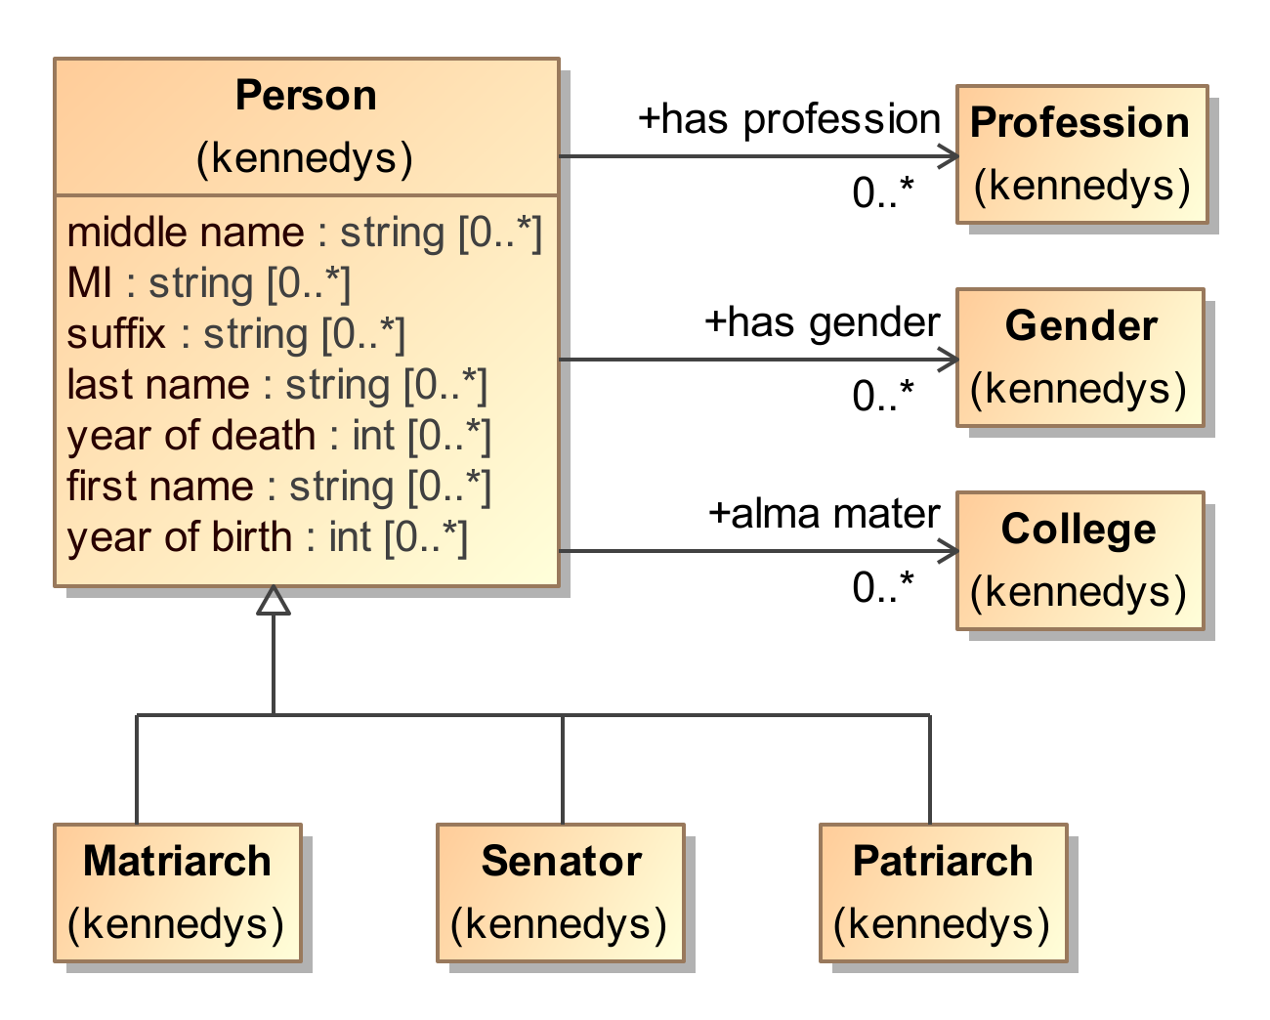
Example of Instantiation

Slide 16
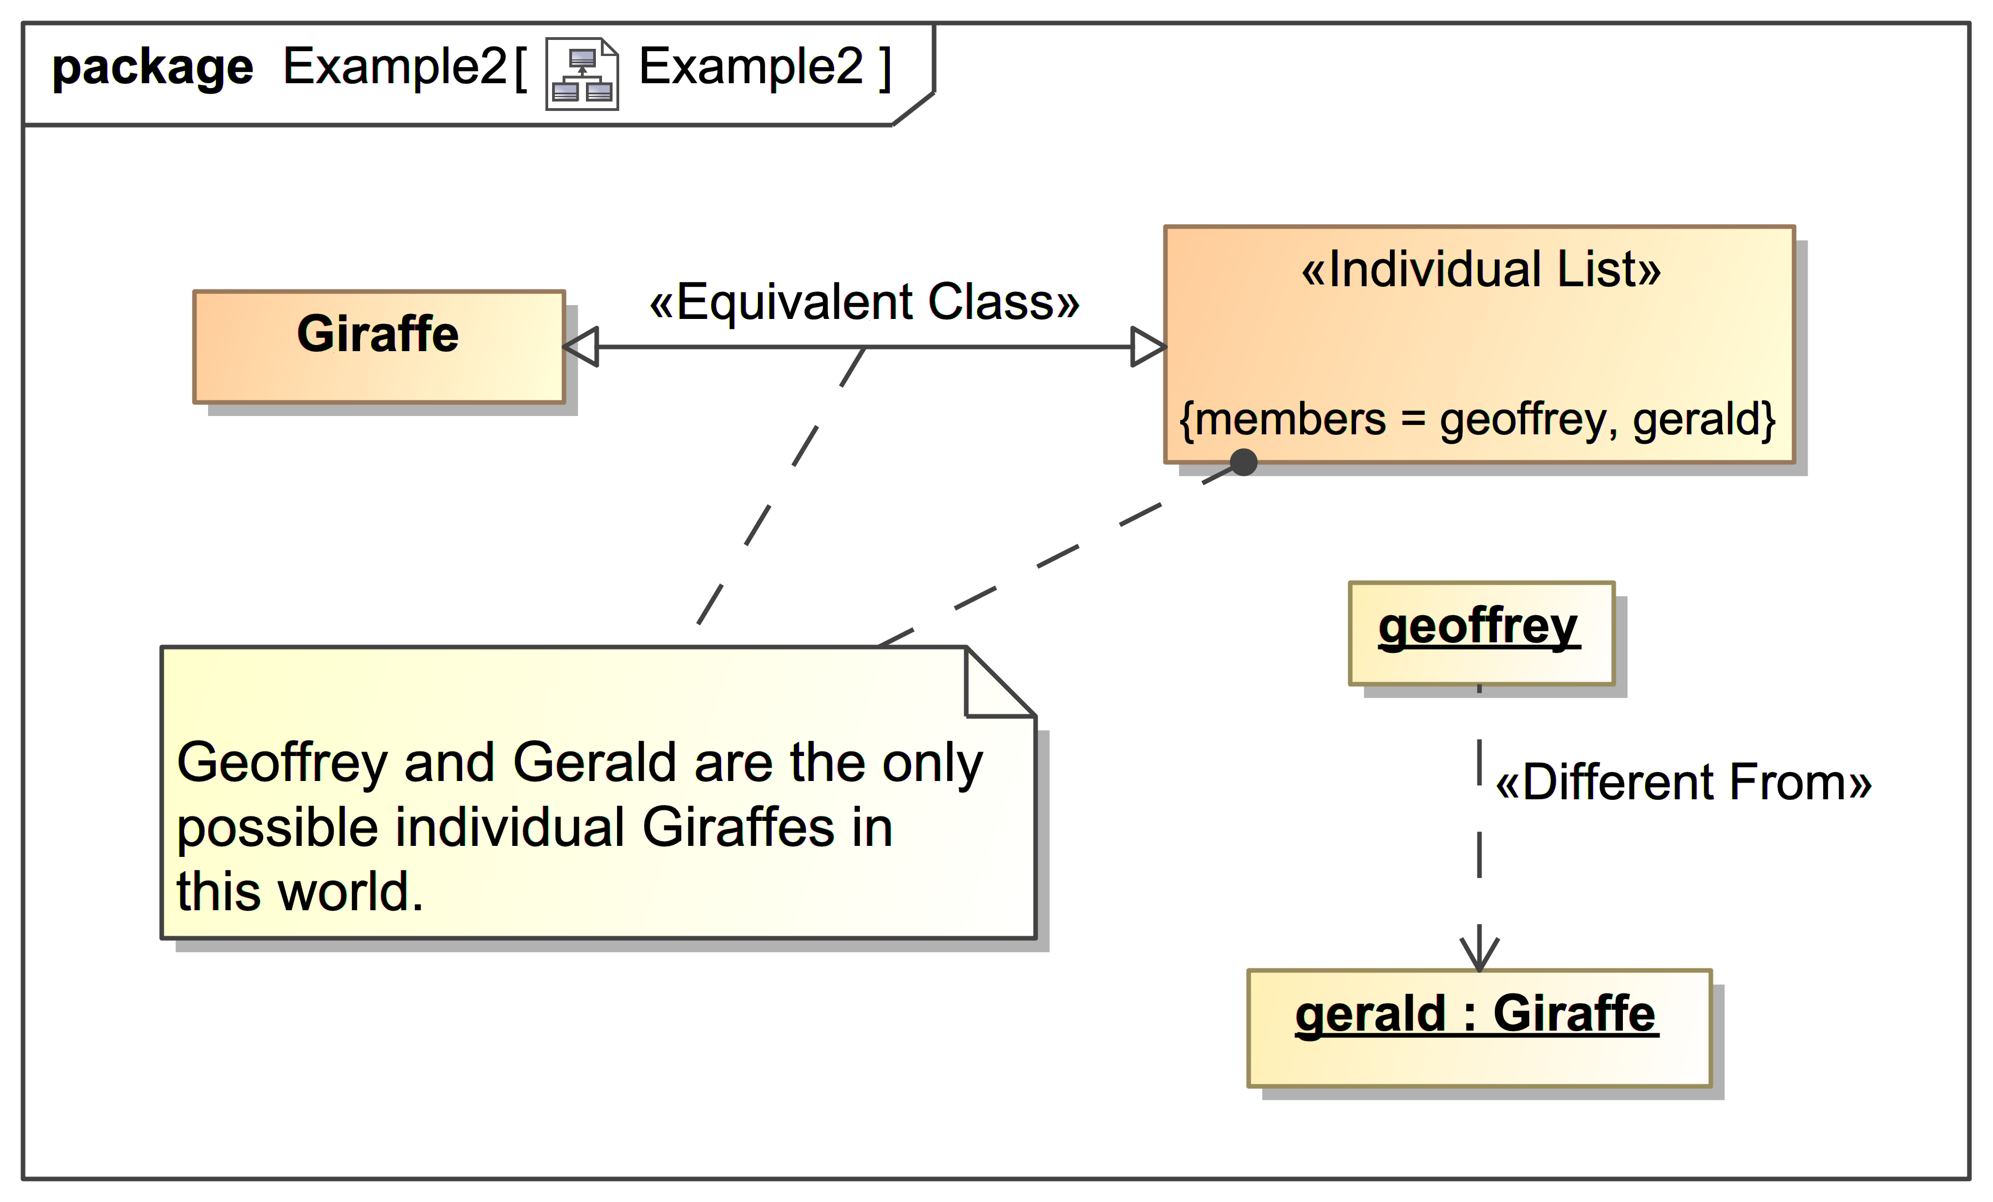
Example of Equivalence and Nominalization

Slide 17
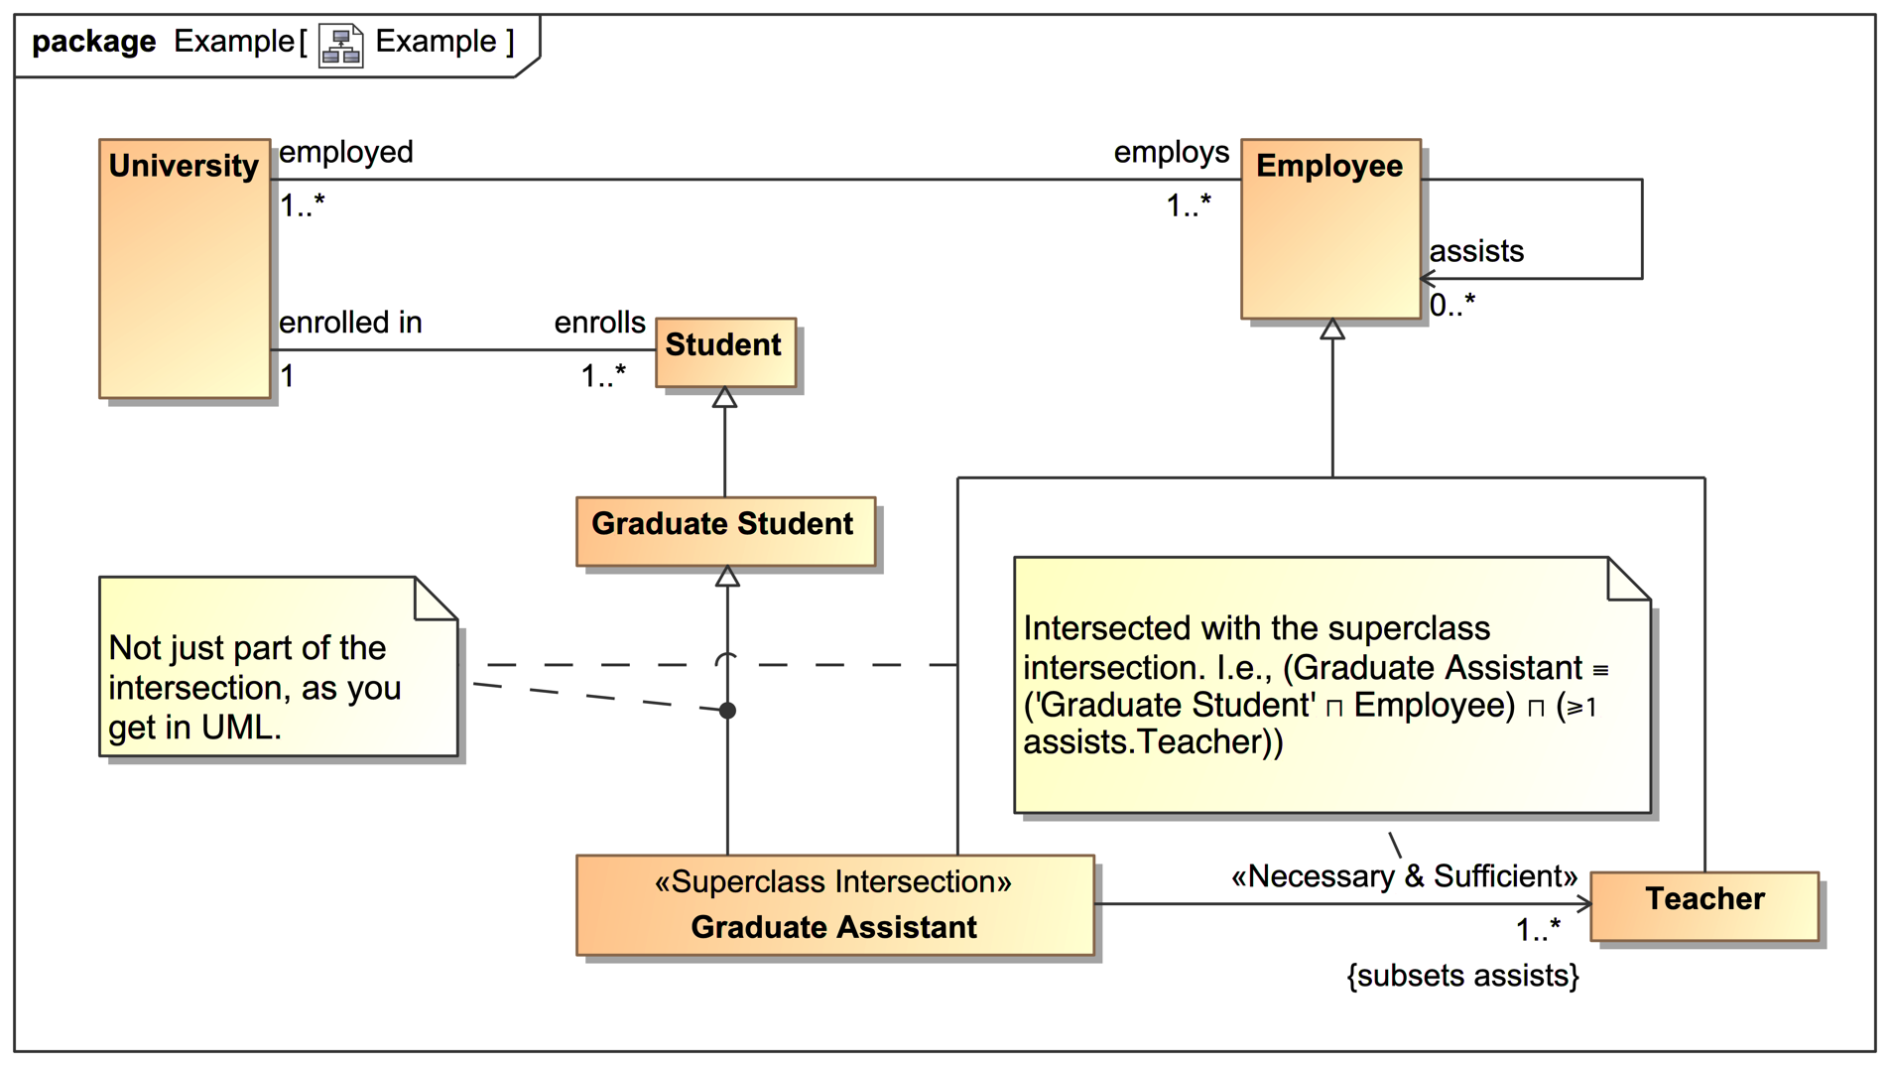
Example of Intersected Concepts

Slide 18
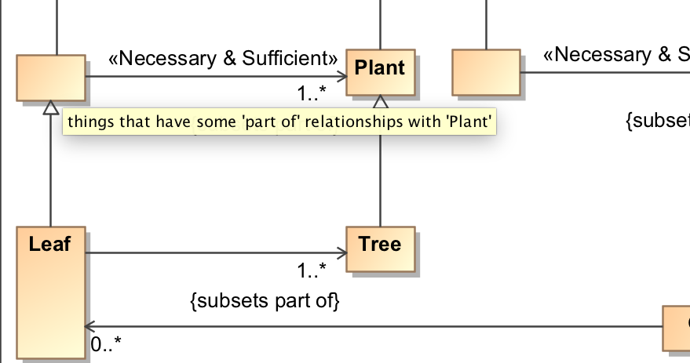
Example of Anonymous Concept Descriptions
Derived descriptions generated for anonymous concepts
Hover over a concept to see the description

Slide 19
High Level Patterns
Phases (e.g., egg, larva, pupa, adult)
Roles (e.g., person as employee of Potbelly’s and employee of McDonald’s)
Association classes (e.g., “employs” vs. “employment” reification)

Slide 20
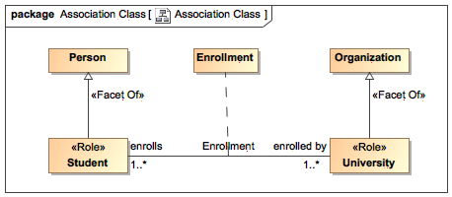
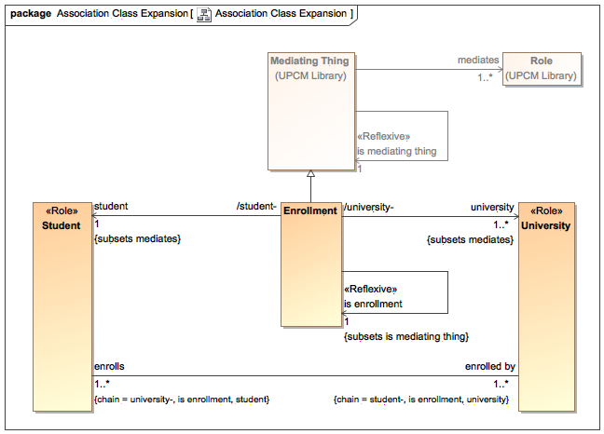
Example of Association Class Expansion

Slide 21
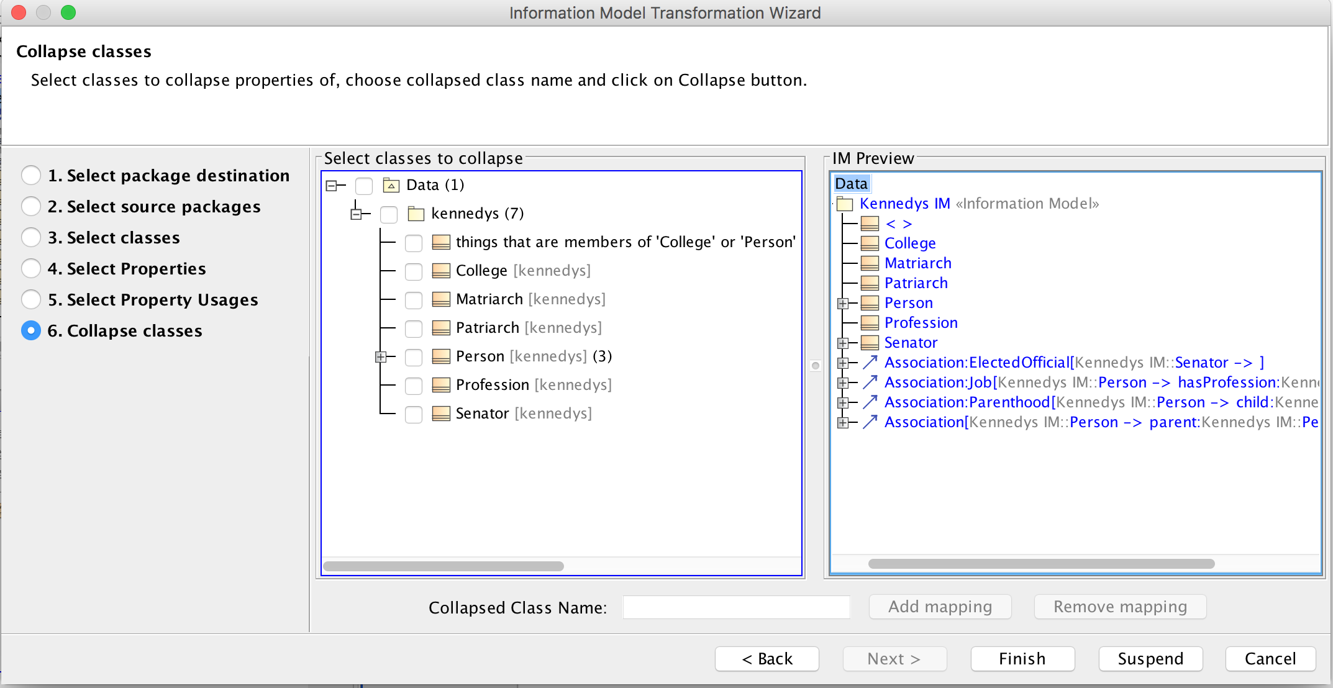
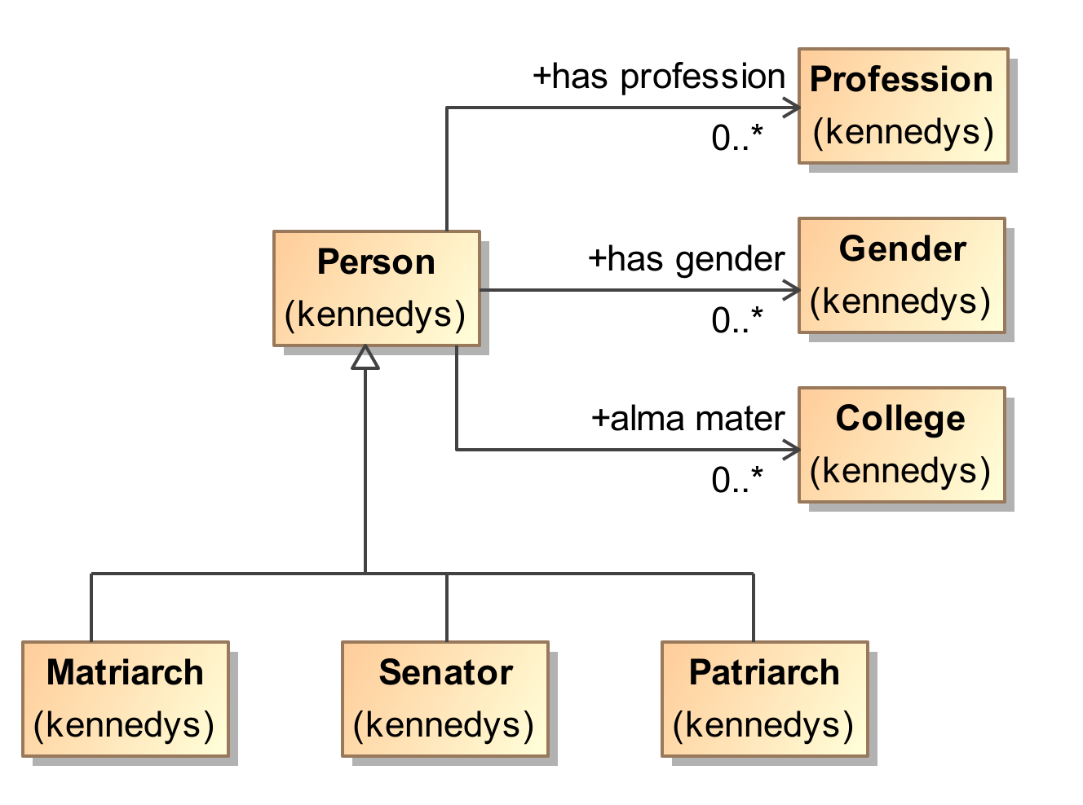
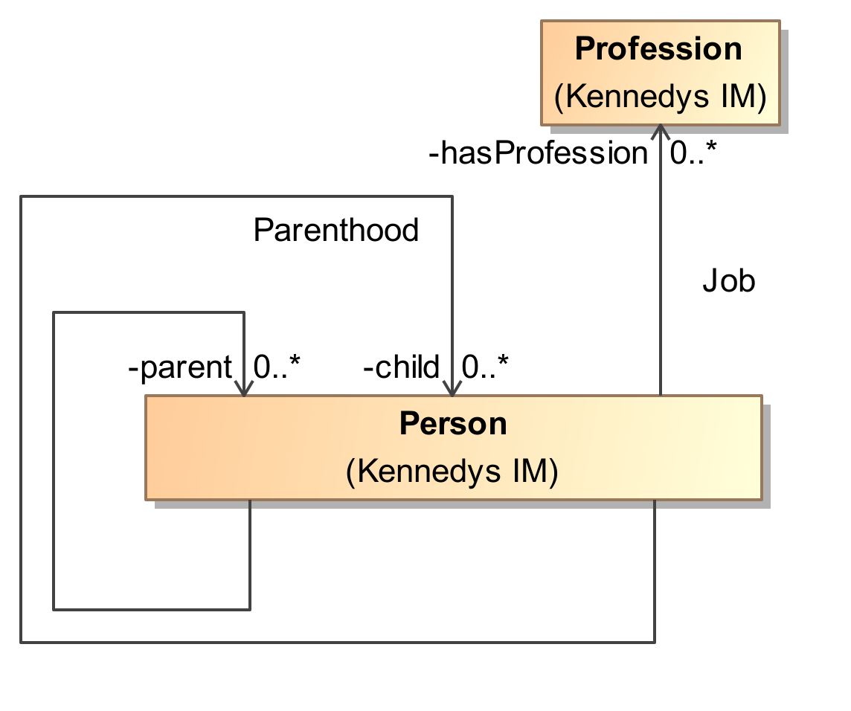
Transformation to Information Model

Slide 22
Related Products
MagicDraw for software analysis, architecture, and design (UML)
Cameo Systems Modeler for model-based system engineering (SysML)
Cameo Enterprise Architecture for enterprise architecture (DoDAF, MODAF, NAF, UAF)
Cameo Business Modeler for business analysis (BPMN 2)
Cameo Simulation Toolkit for model execution (fUML, SCXML, and UPDM)

Slide 23

Academic Program
“No Magic may at their discretion offer educators other MagicDraw editions or products at a discounted rate or at no charge, on a case-by-case basis or in special situations.”
Email: academic@nomagic.com
Web page: https://www.nomagic.com/services/academic-research

Slide 24
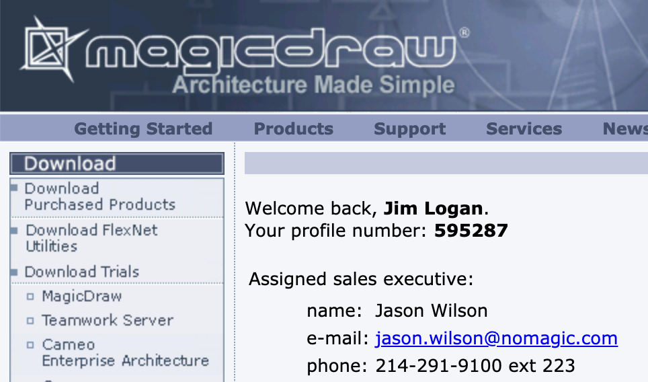

Evaluating CCM (and Others)
Register for an account at www.nomagic.com
Log in and download what you want
Request an unrestricted evaluation license from your assigned sales executive

Slide 25
For More Information
Get a demo here
Schedule an extended demo later
Email:
sales@nomagic.com
James.Logan@3ds.com
Web page:
www.nomagic.com

Slide 26
Questions?

